Slide 1


Intro to Serverless

Slide 2
Agenda
Slides
Demo
Sample Exam Questions

Slide 3
What is Serverless?
Event-driven, scheduled
Automatic horizontal scaling
Billed by usage, starting at $0

Slide 4
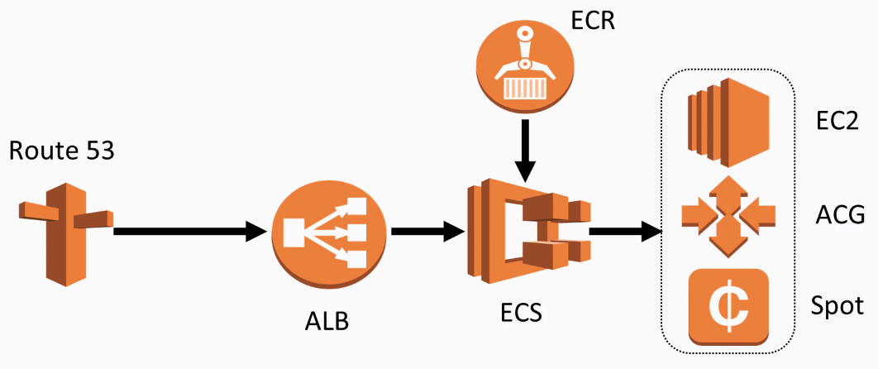




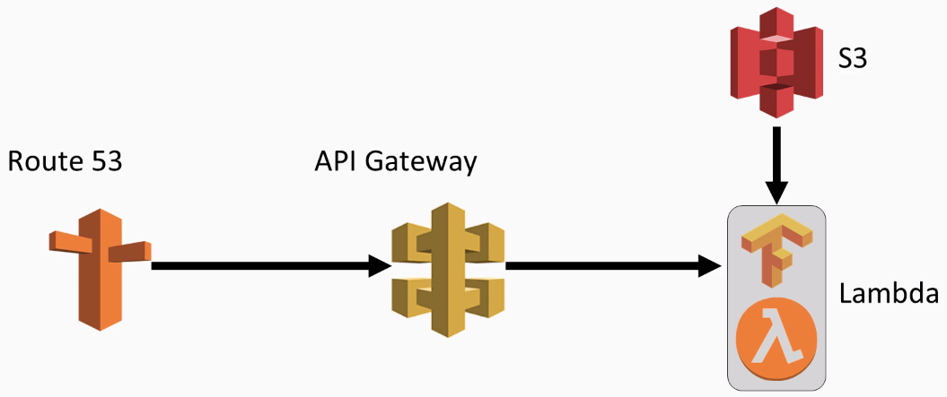
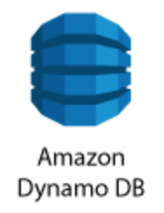
Traditional
Serverless
ELB
Notes:
https://subscription.packtpub.com/book/big_data_and_business_intelligence/9781838551605/1/ch01lvl1sec11/traditional-versus-serverless-architecture-using-lambda

Slide 5
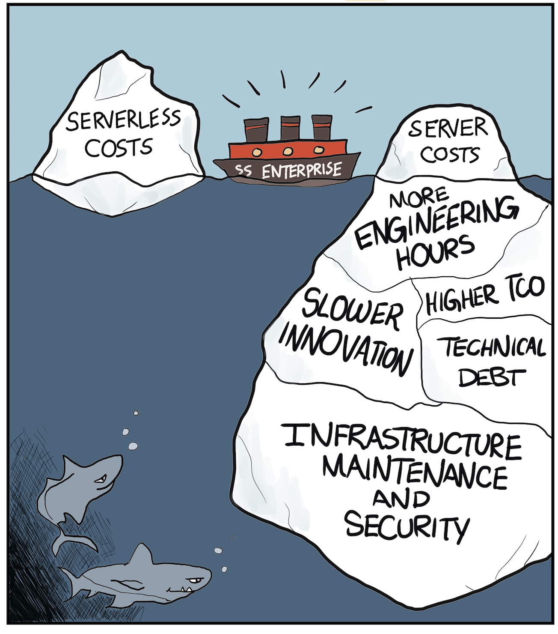
What is Serverless?
No server maintenance
No sys admin
No load balancing
No scaling

Slide 6
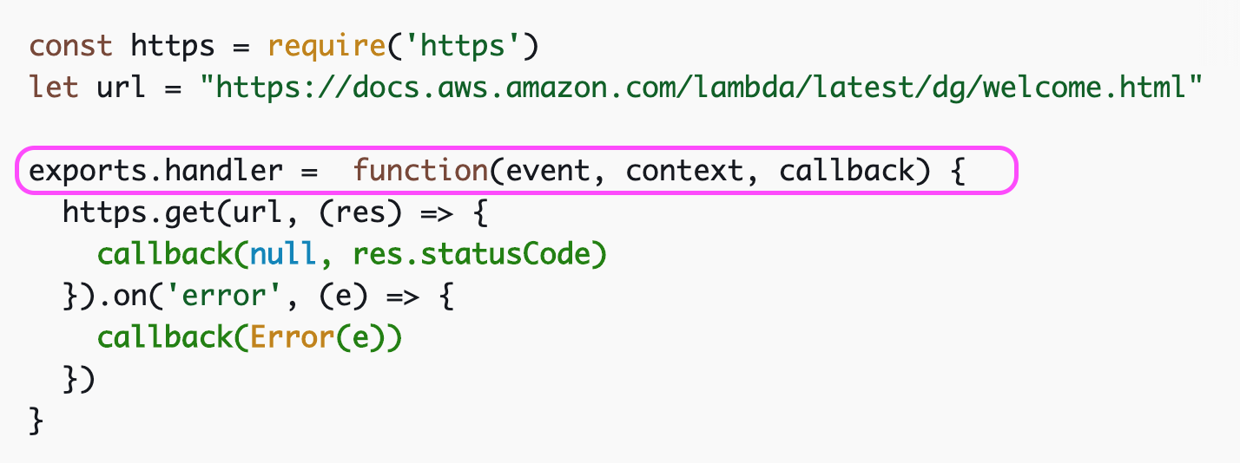
What is Serverless?
Notes:
Sample handler https://docs.aws.amazon.com/lambda/latest/dg/nodejs-handler.html

Slide 7
Offerings
AWS Lambda
We are here
AWS Fargate
(containers)
AWS RDS Aurora Serverless
(relational database)
Google Cloud Functions
Azure Functions
Link: frameworks, platforms chart

Slide 8
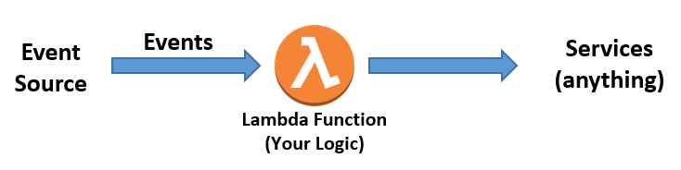
Events: SQS, Kinesis, DynamoDB, MSK
Triggers: API Gateway, AWS IoT, Alexa, ELB, CloudFront, CloudWatch, CodeCommit, Cognito, S3, SNS, SES, …
Node.js
Java
Python
.NET (C#, PowerShell)
Go
Ruby
custom runtimes
Notes:
MSK = Managed Kafka
triggers/events: https://docs.aws.amazon.com/lambda/latest/dg/lambda-services.html

Slide 9
Things to Remember
Lambda scales horizontally
1 event calls 1 function
Debug with AWS X-Ray, CloudWatch, CloudTrails
Single VPC

Slide 10
Numbers
memory | 128 MB ~ 3008 MB
timeout | 1 sec ~ 15 min
pricing | $0.20 = 1 mil requests $0.00001667 per GB-sec In 100ms increments
payload | 6 MB (sync) 256 KB (async)
/tmp disk | 512 MB

Slide 11
Other Services
EC2 is not supported
RDS -> SNS -> Lambda
RDS Aurora Serverless
Specific MySQL, Postgres versions
Enable Data API
MySQL native functions trigger lambda
Lambda can trigger lambda
Notes:
Aurora https://docs.aws.amazon.com/AmazonRDS/latest/AuroraUserGuide/AuroraMySQL.Integrating.Lambda.html
RDS https://docs.aws.amazon.com/lambda/latest/dg/services-rds.html

Slide 12
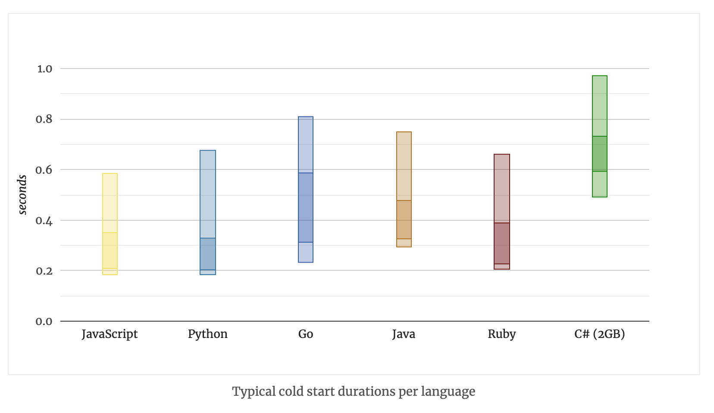
Cold Starts
A lambda container can expire after 30 ~ 45 min
Cold start is usually 0.2 ~ 1.0 sec
Notes:
https://mikhail.io/serverless/coldstarts/aws/

Slide 13
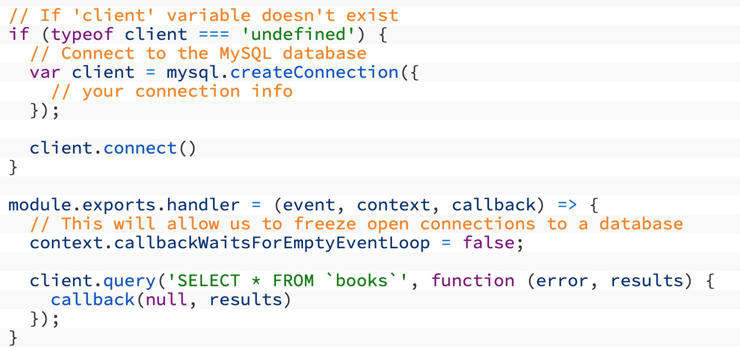
Persistent Connections
Avoid if possible
RDS Aurora Serverless
enable the Data API
RDS non-Aurora
code outside handler can “freeze” for reuse
Notes:
https://www.jeremydaly.com/reuse-database-connections-aws-lambda/ https://www.jeremydaly.com/manage-rds-connections-aws-lambda/
https://docs.aws.amazon.com/AmazonRDS/latest/AuroraUserGuide/data-api.html

Slide 14
VPC
Lambda has a default VPC
Use lambda VPC when interacting with other services in VPCs

Slide 15
Certification Questions
See Jason’s list
Notes:
#8 from https://d1.awsstatic.com/training-and-certification/docs-sa-assoc/AWS-Certified-Solutions-Architect-Associate_Sample-Questions.pdf A company’s security team requires that all data stored in the cloud be encrypted at rest at all times using encryption keys stored on-premises. Which encryption options meet these requirements? (Select TWO.)
A) Use Server-Side Encryption with Amazon S3 Managed Keys (SSE-S3).
B) Use Server-Side Encryption with AWS KMS Managed Keys (SSE-KMS).
C) Use Server-Side Encryption with Customer Provided Keys (SSE-C).
D) Use client-side encryption to provide at-rest encryption.
E) Use an AWS Lambda function triggered by Amazon S3 events to encrypt the data using the customer’s
keys.
Bad question set, with some wrong answers: https://awscoach.net/aws-lambda-certification-questions/

